Slide 2
Rust’s Borrow Checker

Slide 3
This is based on the work described in a paper!
“RustBelt: Securing the Foundations of the RustProgramming Language”
https://people.mpi-sws.org/~dreyer/papers/rustbelt/paper.pdf

Slide 4
Code is awful

Slide 5
Code is awful
Our favorite topic, the failings of traditional language paradigms!

Slide 6
Code is awful
The Billion Dollar Mistake
Threading
ESR calls this an ugly hack, favors IPC

Slide 7
Code is awful
The Billion Dollar Mistake
Threading
ESR calls this an ugly hack, favors IPC
The real problem is managing your search space.

Slide 8
Code is awful
How much can you prove about your code?
How much does your type system give you?
How quickly do you identify that a problem exists?

Slide 9
Code is awful
Java!

Slide 10
Code is awful
Java!
http://wouter.coekaerts.be/2018/java-type-system-broken
https://www.cs.rice.edu/~javaplt/papers/oopsla2008.pdf

Slide 11
Code is awful
C#!

Slide 12
Code is awful
C#!
https://stackoverflow.com/questions/123506/c-sharp-compiler-incorrectly-optimizes-code

Slide 13
Code is awful
C!

Slide 14
Code is awful
C!
https://llvm.org/pubs/2008-10-EMSOFT-Volatiles.pdf
http://www.cs.utah.edu/~regehr/papers/pldi11-preprint.pdf
https://www.youtube.com/watch?v=tU5HfVc2nR8

Slide 15
Code is awful
Go!

Slide 16
Code is awful
Go!
https://github.com/golang/go/issues/22350
https://twitter.com/SusanPotter/status/1129593107710922752

Slide 17
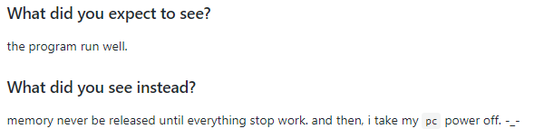
Code is awful
Go!

Slide 18
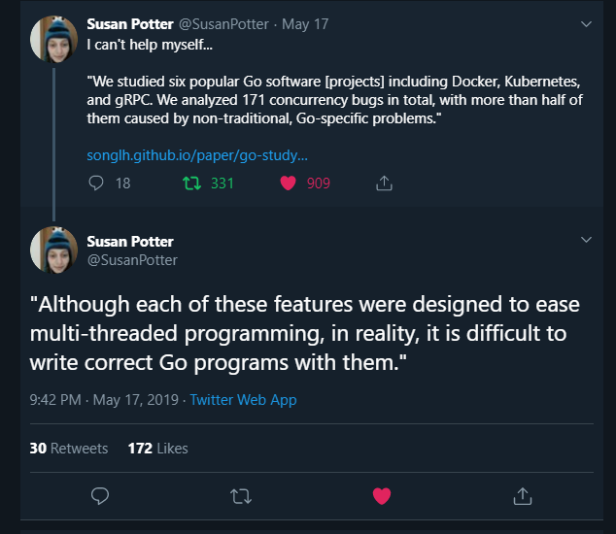
Code is awful
Go!

Slide 19
Code is awful
Haskell!

Slide 20
Code is awful
Haskell!
(Yes, really)

Slide 21
Code is awful
Haskell!
https://gitlab.haskell.org/ghc/ghc/issues/163
https://replit.canny.io/bug-reports/p/haskell-getline-bug-again

Slide 22
Code is awful
Nevermind…
Security Vulnerabilities
Risk to Life
Medical Device Firmware
Vehicle Firmware
Lost Dev Time
Site Reliability...

Slide 23
Is there hope?

Slide 24
Is there hope?
Tests?
Types?
Oncall Rotations?
Code Reviews?
Continuous Integration?
Automatic push?
Health checks?
Prayer?
Sacrifices?

Slide 26
Be Brave. There is yet hope.

Slide 27
Why do bad things happen to good processes?

Slide 28
Part one: Multiple Aliases
In C/C++, you would say that you have a memory address, with multiple pointers to that address across different threads.
Without any kind of locking or mutexing, this gives rise to a race condition.

Slide 29
Part one: Multiple Aliases
More formally:
Multiple Aliases (pointers)
To a resource (memory address/variable)

Slide 30
Part one: Multiple Aliases
More formally:
Multiple Aliases (pointers)
To a resource (memory address/variable)
This still leaves us in a data race. Rust’s locking mechanism is Ownership.

Slide 31
Part one: Multiple Aliases
A lock enforces that only one code location has access to … something.
Critically, this is opt-in. You have to wrap the operations you're doing to avoid a data race
Ownership, being a type system mechanism, is opt-out.
unsafe is available if you need to do black magic.
However, obviously, you're on your own.

Slide 32
Conclusion one!

Slide 33
Conclusion one!
We need to prove that the Ownership model is sound.
We need to prove that following the type system in rust yields a program without unsafe/undefined behaviors.

Slide 34
unsafe considered… unsafe

Slide 35
unsafe considered… unsafe
There are many cases where the performant version of the algorithm flagrantly defies the borrow checker.
Many of those cases are in the Rust standard library.

Slide 36
unsafe considered… unsafe
This has lead to data races that only show up if a particular combination of standard libraries are used together.
The libraries in question use unsafe internally. They are well behaved in isolation.

Slide 37
unsafe considered… unsafe
This has lead to data races that only show up if a particular combination of standard libraries are used together.
The libraries in question use unsafe internally. They are well behaved in isolation.

Slide 38
unsafe considered… unsafe
There are at least two papers documenting multi-library data race bugs.
This gives you some idea of how much fun it was to troubleshoot and fix. :-)

Slide 39
Conclusion Two!

Slide 40
Conclusion Two!
We need to prove that the Ownership model is sound.
We need to prove that following the type system in rust yields a program without unsafe/undefined behaviors.

Slide 41
Conclusion Two!
We need to prove that the Ownership model is sound.
We need to prove that following the type system in rust yields a program without unsafe/undefined behaviors.
We also need to prove that the use of unsafe in the stdlib is…. Safe.

Slide 42
Formal Verification

Slide 43
Formal Verification
Formal Verification is unique.
It tests a desgin specification.
It’s common to be done before a single line of code is written

Slide 44
Formal Verification
“If implemented correctly, will this design work?”

Slide 45
Formal Verification
There are lots of ways this is done.
TLA+
Temporal Logic of Actions
Coq, Agda, QuickCheck, others.
Iris
https://iris-project.org/

Slide 46
Iris
Iris is written in Coq
It’s specifically designed to reason about the problem domain we’re working in!
From the website:
Iris is a Higher-Order Concurrent Separation Logic Framework implemented and verified in the proof assistant Coq.

Slide 47
Example Programs
Live coding because what could go wrong! :-D

